Slide 1
Creating a SW support TAC Case
Ways to open a case with TAC:
Web Tool : https://mycase.cloudapps.cisco.com/case
Each of these options will ask for your CCO ID and contract number. Always use your CX EA contract number

Slide 2
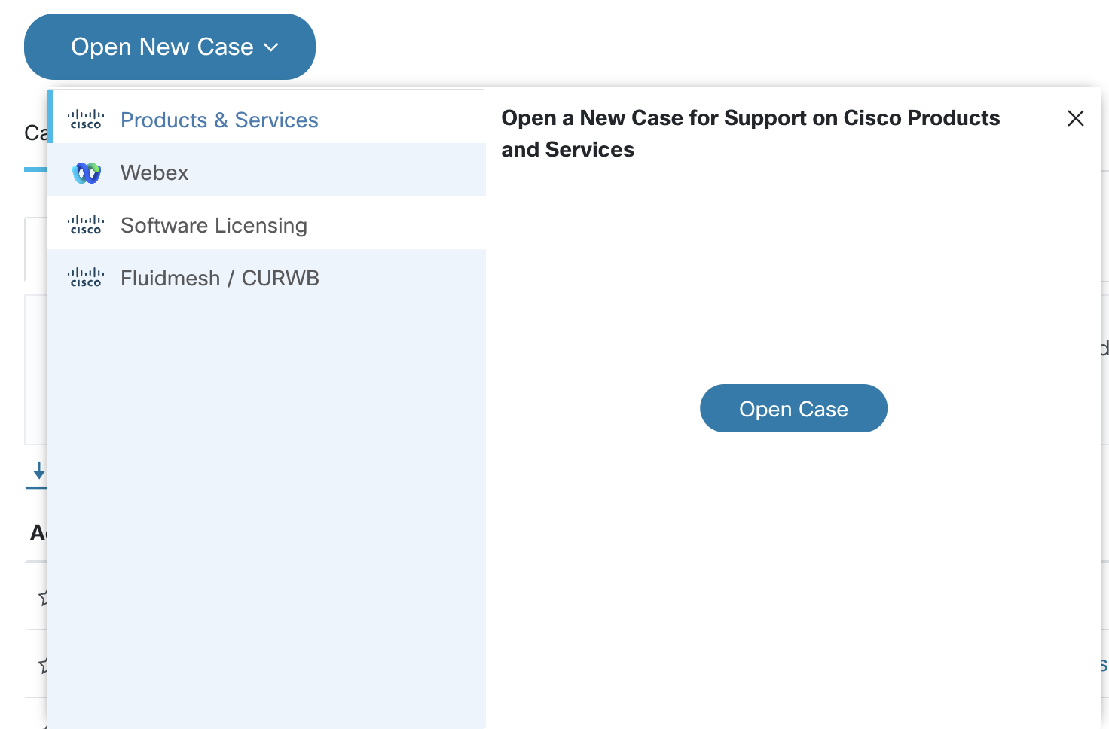

Slide 3
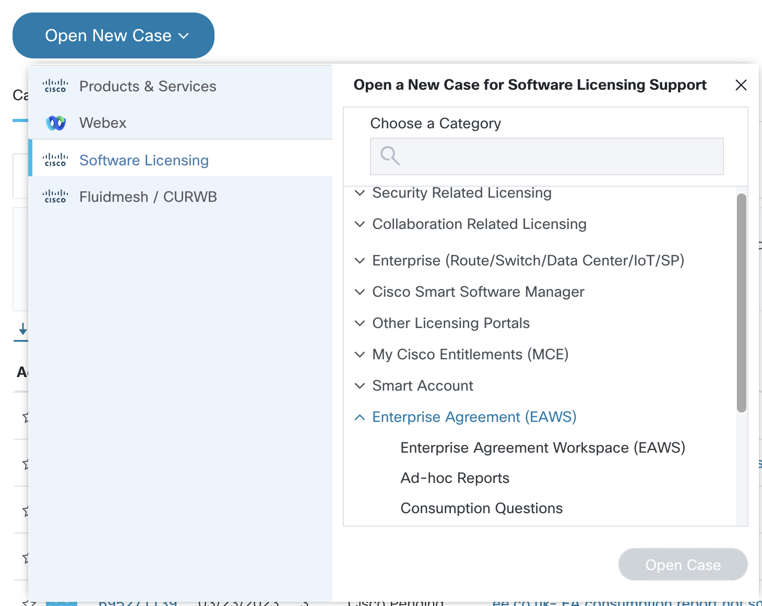

Slide 4
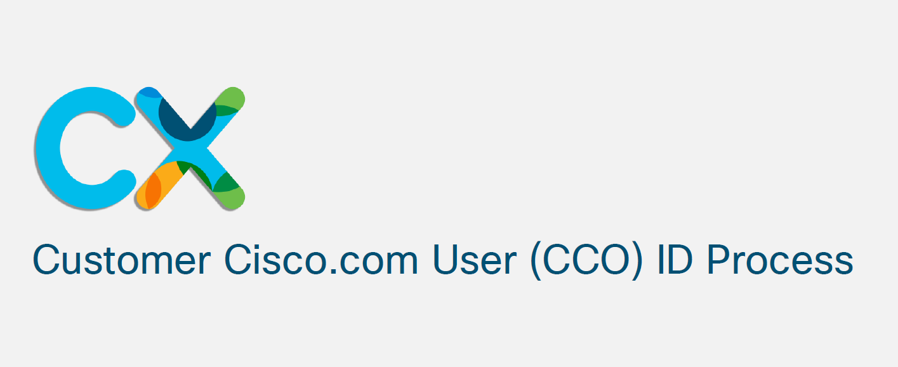
Contract association

Slide 6
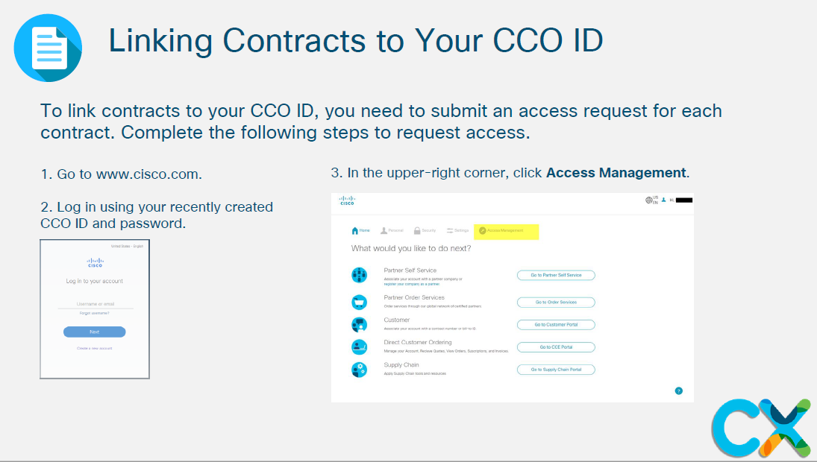

Slide 8
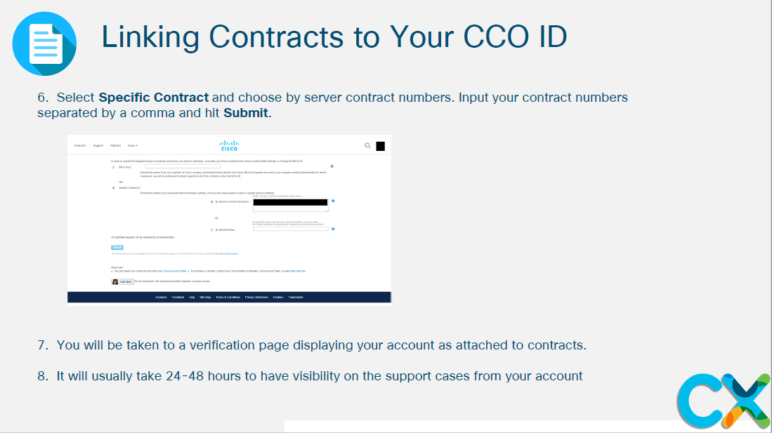
If you need help while using the Cisco.com tool email: web-help@cisco.com

Slide 9
Notes:
Closing slide

